Slide 1
STRUCTURL PATTERN
Adopter Pattern

Slide 2
Contents
What are the adopter design pattern
Intent
Examples
Problems
Applicability
Structure

Slide 3
Adopter Design Pattern
Pattern Name
Adopter Design Pattern
Intent
The adapter design pattern allows two incompatible classes to interact with each other by converting interface of one class into an interface expected by the client .
Language dependent, Architecture different , interface different
Adapter pattern works as a bridge between two incompatible interfaces.
Adapter dp is a class which allows two incompatible classes to interact with each other

Slide 4
Example Adopter Design Pattern
We want to save memory card data in laptop but it is not possible directly because we have no compatibility b/w interface .We need an interface who convert data in lap top. Adapter work as bridge b/w two interfaces
Memory card reader
Lap top
Card reader

Slide 5
Example Adopter Design Pattern
I phone charger
Can not work in android phone

Slide 6
Adopter Design Pattern
Problem
Adapter lets classes work together that couldn’t otherwise because of incompatible interfaces

Slide 7
Applicability
When two incompatible classes interact with each other

Slide 8
Purpose
visually representing a system along with
Actors
Roles
Actions
artifacts or classes
to better understand a system

Slide 9
UMLs:
use case
Class
Sequence
State
Activity
object
component

Slide 10
Note:
interface diagram is not UML diagram

Slide 11
Use Case Diagram
Already discussed

Slide 12
Class Diagram
Class diagram describes
the attributes
operations
Constraints(if present) imposed on the system

Slide 13
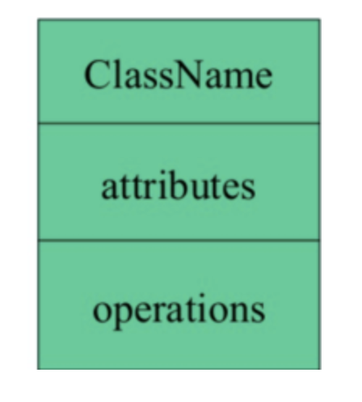
Elements of Class Diagram

Slide 14
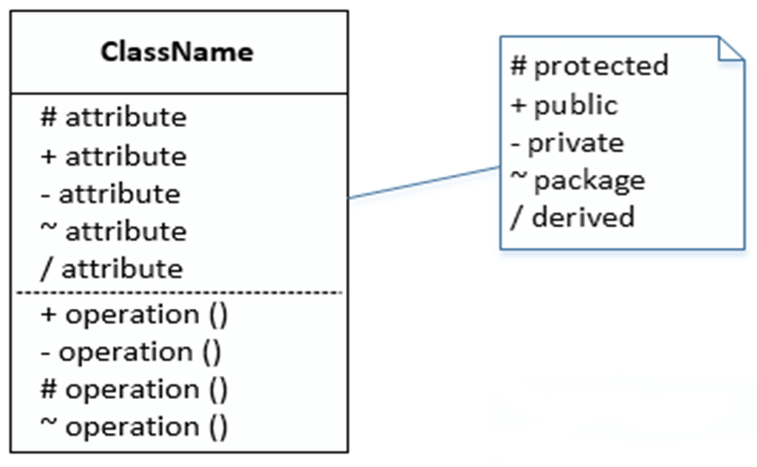
Visibility

Slide 15
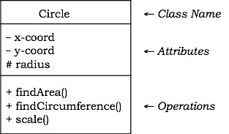
Example class

Slide 16
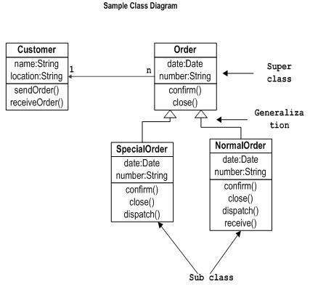

Slide 17
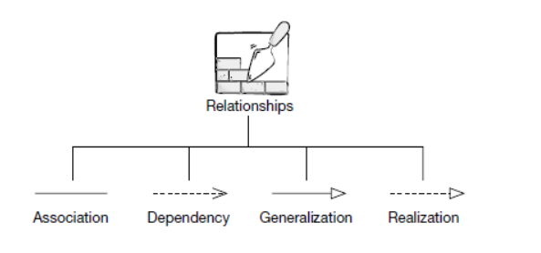
Types of relationships

Slide 18
Relationships in Class Diagrams
Classes are interrelated to each other
Relationships include different types of logical connections
Inheritance/Generalization
Association
Aggregation
Composition
Reflexive Association
Dependency
Realization

Slide 19
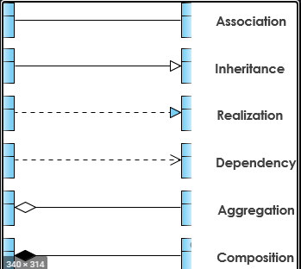
Relationship Notation

Slide 20
Inheritance
“is-a” relationship
Example : shape class
Circle is a shape; Rectangle is a Shape.

Slide 21
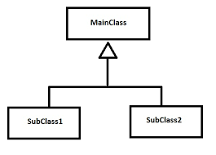
Inheritance

Slide 22
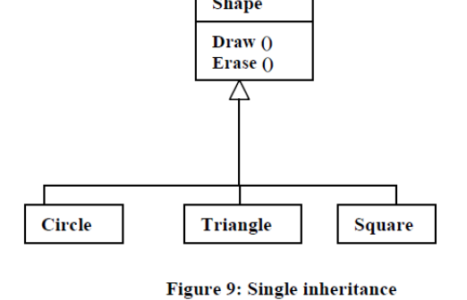
Generalization

Slide 23
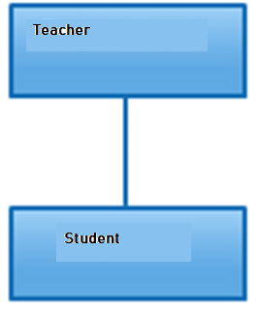
Association
Its a broad term that encompasses just about any logical connection or relationship between classes.

Slide 24
Association
has-a” relationship
In this relationship all objects have their own lifecycle and there is no owner
Both can create and delete independently.

Slide 25
Association---Aggregation
Specialized form of Association
All objects have their own lifecycle
Example: Department and teacher
but if we delete the department teacher object will not be destroyed.
We can think about it as a “has-a” relationship.

Slide 26

Aggregation

Slide 27
Composition
Composition is again specialized form of Aggregation
this as a “death” relationship.
. It is a strong type of Aggregation
if parent object is deleted, all child objects

Slide 28
Composition: Example 1
House and Rooms.
House can contain multiple rooms – there is no independent life of room and any room can not belong to two different houses. If we delete the house – room will automatically be deleted

Slide 29
Composition: Example 2
relationship between Questions and Options.
Single questions can have multiple options and option can not belong to multiple questions. If we delete questions options will automatically be deleted

Slide 30

Composition

Slide 31
Thankyou

